Slide 1



KONGU ENGINEERING COLLEGE
PERUNDURAI ERODE-638060
Department of Computer Applications – PG
Title: On stream portal for paint shop
TEAM-06
Guided By:
Dr. P.VIJAYAKUMAR
Team Members
BALACHANDRAN S (24MCR007)
GHAUTHAM M (24MCR025)
JEGADEEP P (24MCR045)

Slide 2
PROJECT OVERVIEW
The Online Portal for the paint shop designed to provide a seamless and efficient digital experience for customers seeking high-quality paint products and services.
This user-friendly platform will cater to both DIY enthusiasts and professional contractors, ensuring easy access to a wide range of offerings.
This is developed like online shopping and it also maintains the customer details and purchase details, etc. It includes some tasks such as customer details, product details, product price, purchase details, etc.

Slide 3
OBJECTIVE OF PROJECT
Stock maintainance
Category of the product
User-friendly interface
Report generation
Order confirmation
Payment gateway

Slide 4
EXISTING SYSTEM
The current system uses traditional in-store methods and has no online features. Products and stock levels are tracked manually, and sales are done through basic systems. Customers can only get information in person or from labels, and payments are made with cash or cards at the counter.
Stock is checked and restocked by hand. Without an online platform, the store cannot reach more customers or share product details outside the shop. Adding online features can solve these issues and improve the store.

Slide 5
PROPOSED SOLUTION
Online Catalog: Build a comprehensive online catalog showcasing interior paints and exterior paint products with high-quality images, descriptions, and filters to simplify product search and selection
Reduces the human effort compared to other conventional methods.
Accuracy and error free transaction process.
Reports are easily prepared and efficient.
User Data is maintained by the database and reduces data loss.
Help the user to reduce the workload and mental conflict.
Long distance people can also buy paints easily.

Slide 6
MODULES
Home Page
Login
Register
Product
Cart
Admin
Order

Slide 7
MODULES DESCRIPTION
Home Page: The module contains feedback form, products, search bar
Registration Form: The module gathers customer data such as name, contact number, and email, which is stored in a database table for company asset management.
Product Details: This module maintains information about paints, including product name, description, quantity, and price.
Order Details: The Order Details module is designed to gather all relevant information about the products being ordered.

Slide 8
Administrator Module: The Administrator has the right to access the system, maintain and modify database data, including user details, using their username and password.
Login Module: The login module allows both administrators and customers to access the system, with the administrator having more rights in maintaining system information.

Slide 9
MODULES IMPLEMENTATION
User Management :
User can add the product to cart, make login or logout, make order or cancel it and user get confirmation message through message.
This could include viewing and modifying user details such as name, phone number, profile picture, etc..
Admin Management:
Admin should have the ability to manage other accounts.
Implement features like adding new admin or modifying the permissions
Admin can able to add or remove the product in the page.

Slide 10
TECHNOLOGIES USED
Front-End:
React JS
JavaScript, CSS
Back-End:
Node JS
Firebase

Slide 11
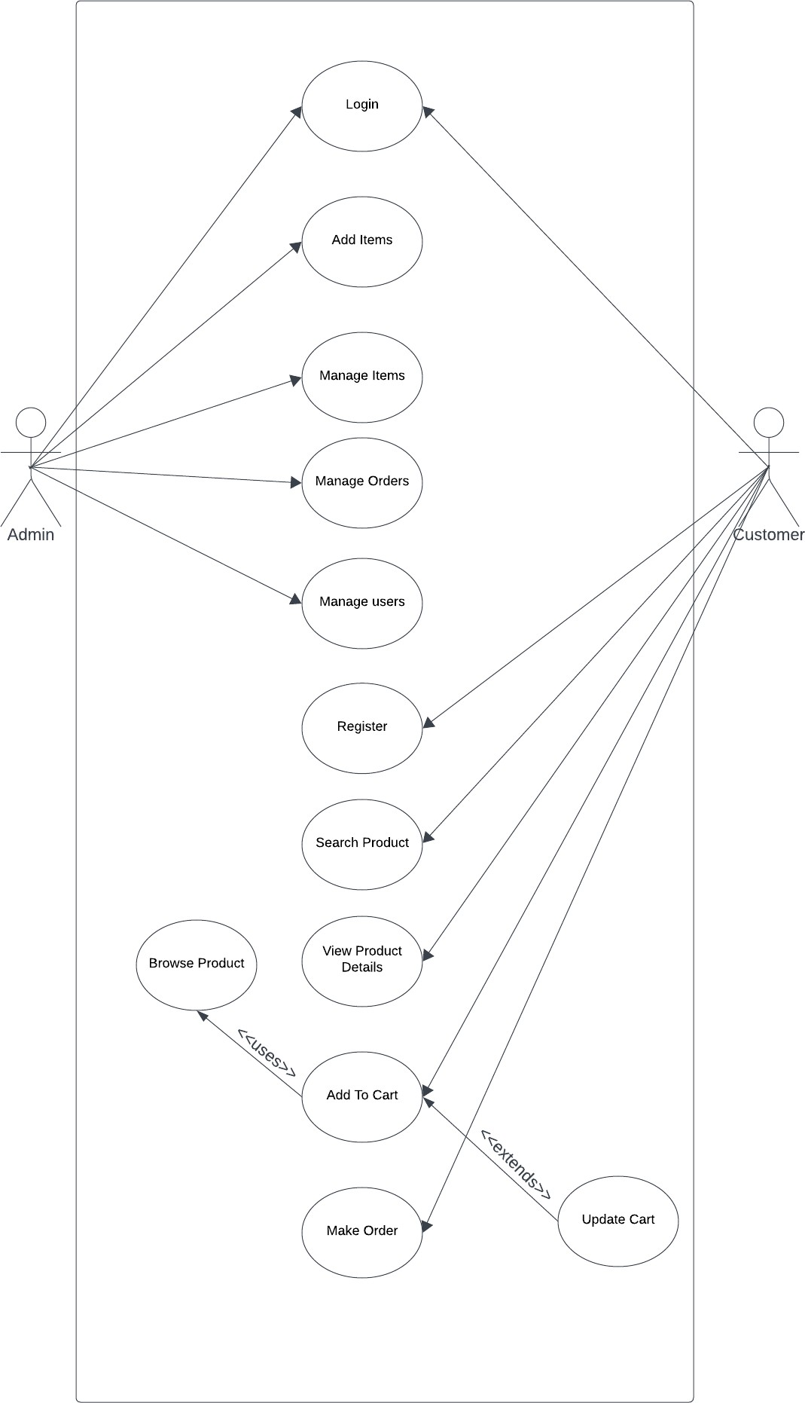
USECASE DIAGRAM

Slide 12
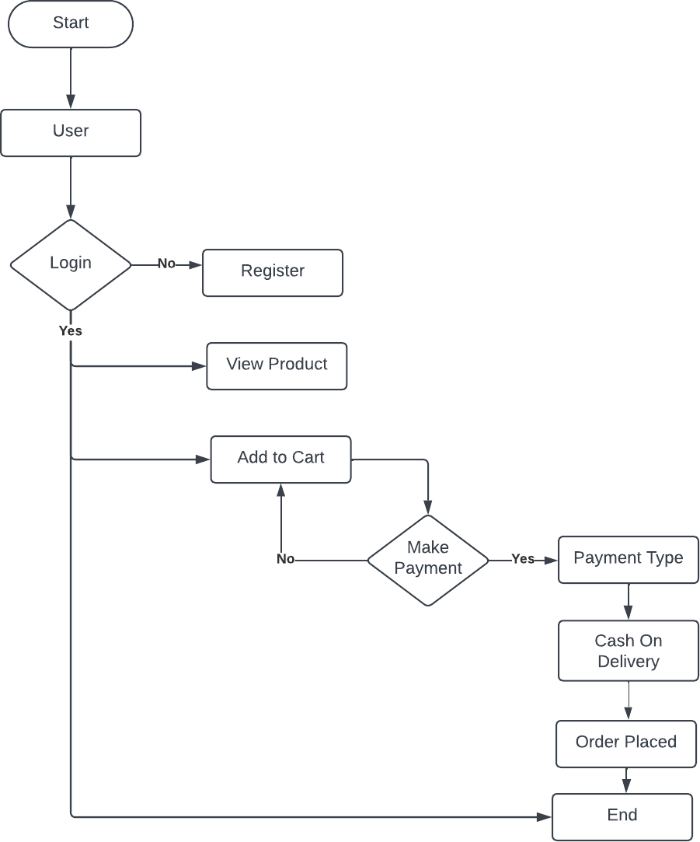
SYSTEM FLOW DIAGRAM

Slide 13
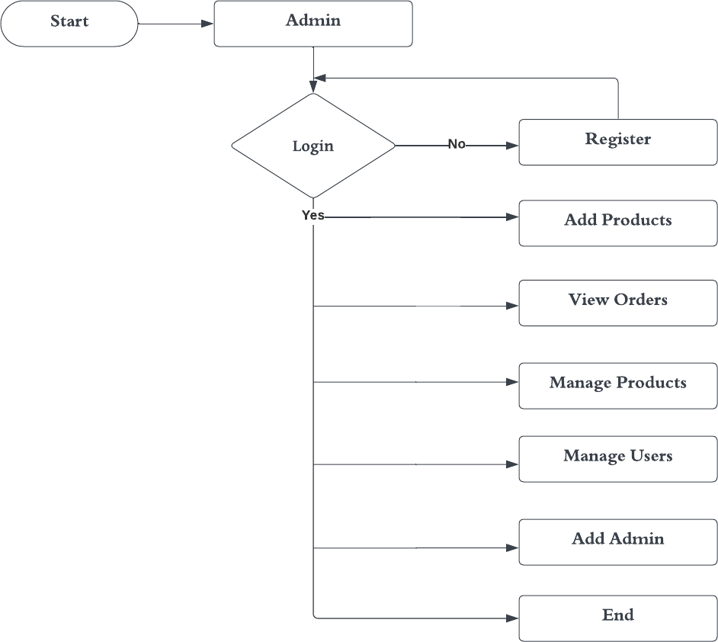
ADMIN SYSTEM FLOW DIAGRAM

Slide 14

USER MODULE IMAGES

Slide 15
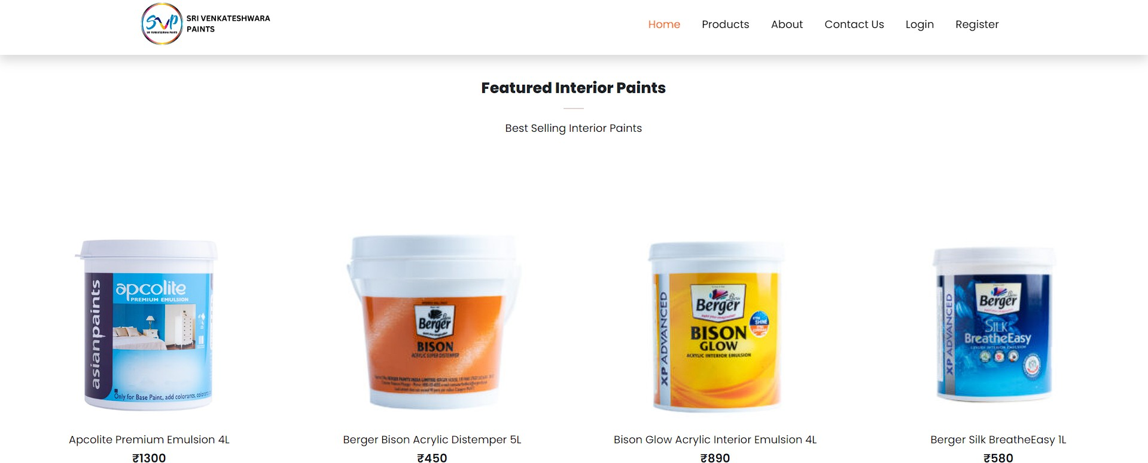

Slide 16
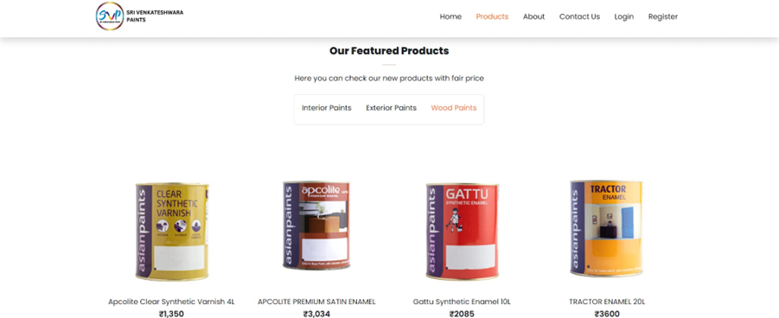

Slide 17
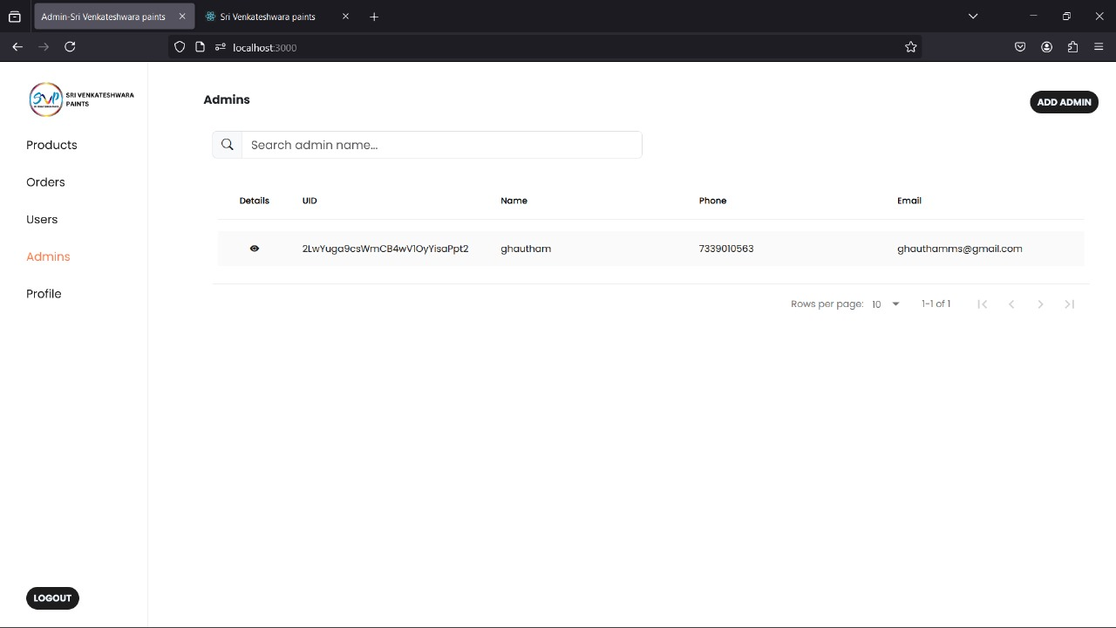
ADMIN MODULE IMAGES

Slide 18
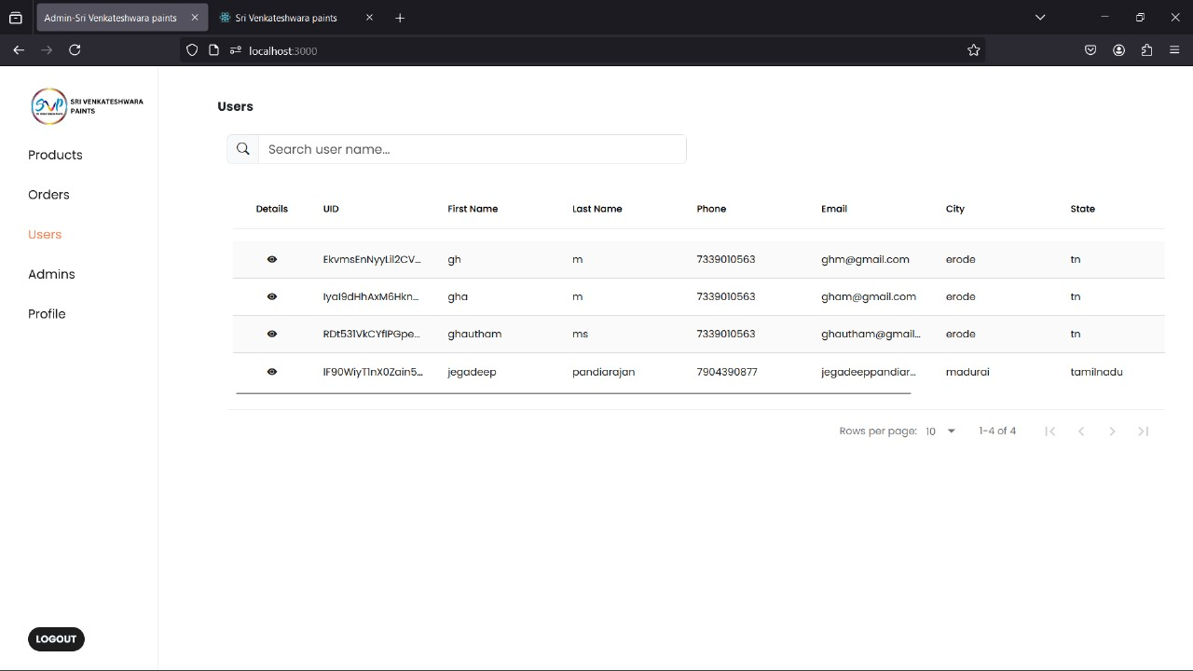

Slide 19
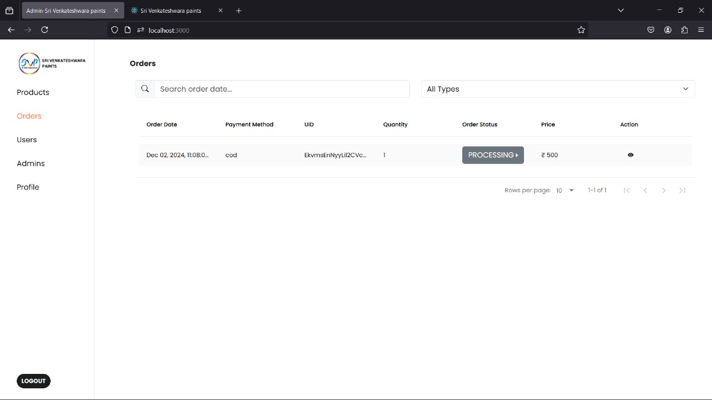

Slide 20
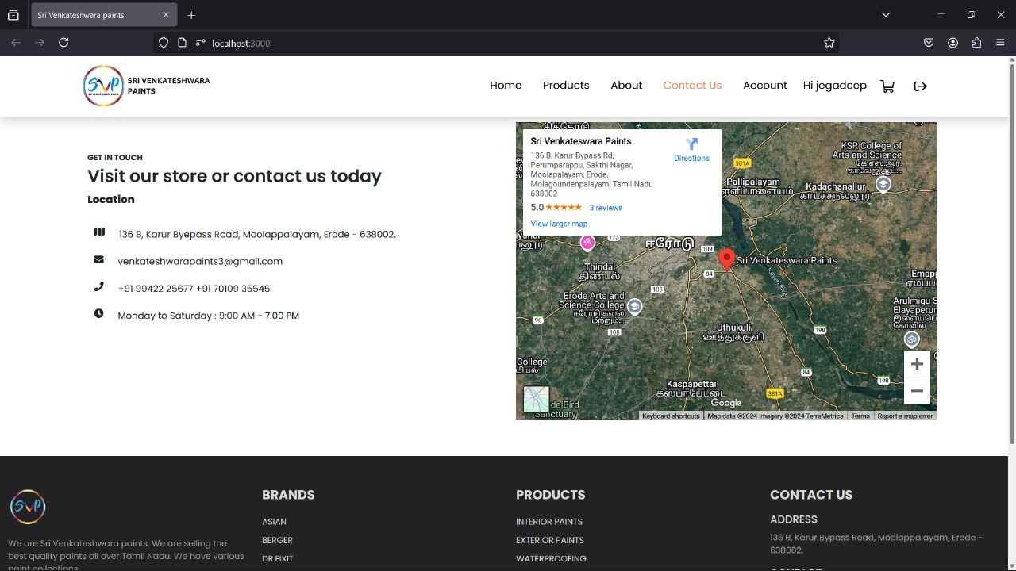
LOCATION

Slide 21
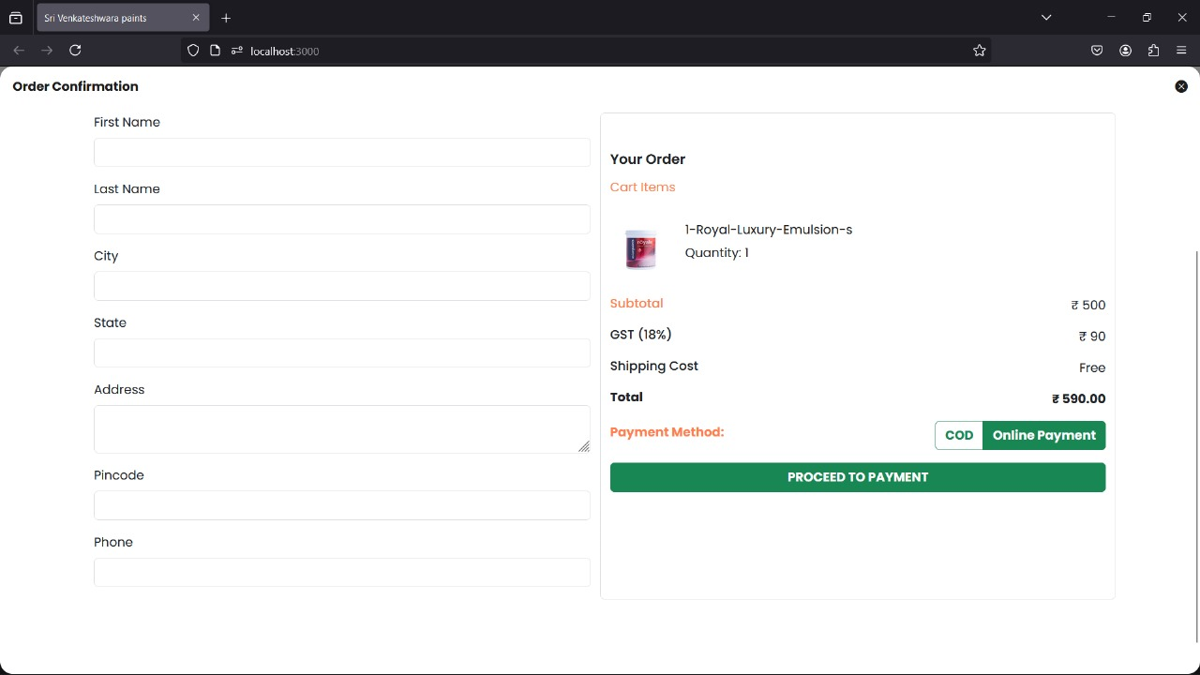
ADD TO CART

Slide 22
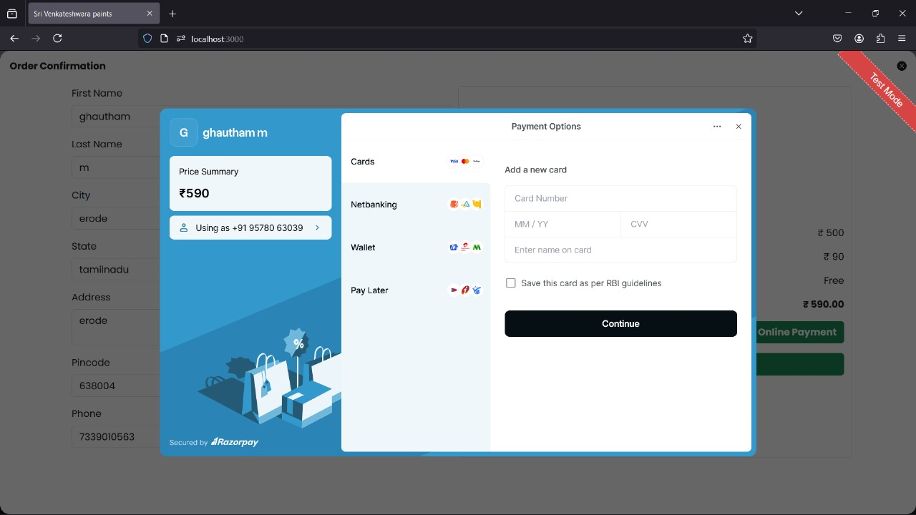
Payment Page

Slide 23
CONCLUSION
In this project, a user friendly web application for paint shop has been developed successfully
Our paint shop stream portal makes it easy to transform your home, inside and out. With a wide range of quality paints, helpful tips, and simple tools, we’re here to help you create the perfect look.

Slide 24
Thank You !!

